Slide 1
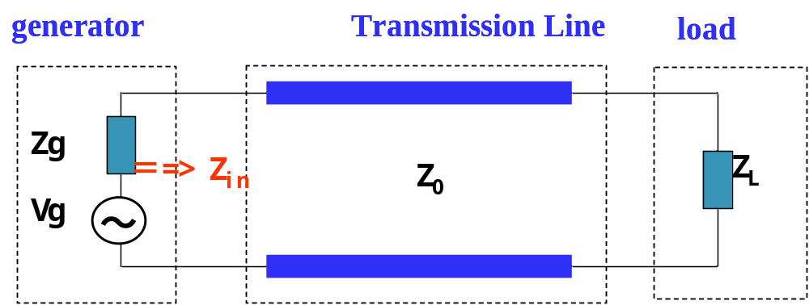
Chapter 3 Impedance Matching
§3.1 Generator and load mismatches
  both generator and load may present mismatched impedances to the transmission line

Slide 2
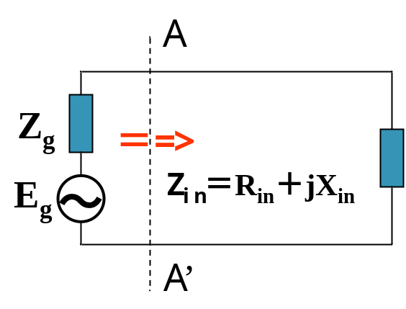
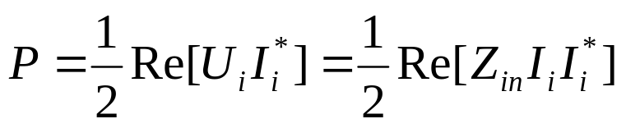
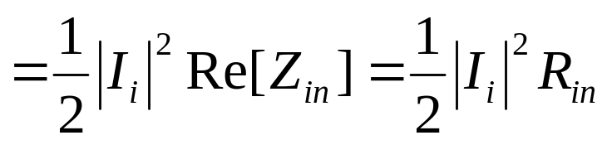
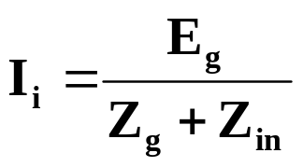
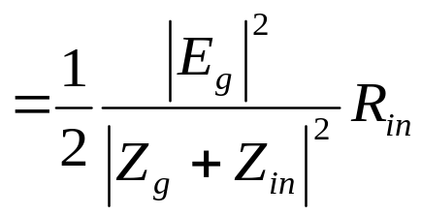

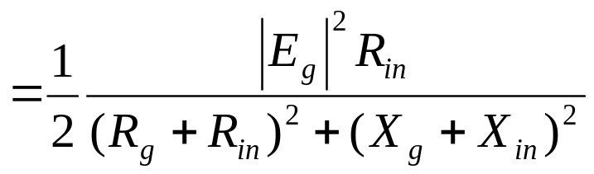
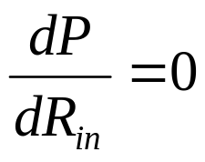
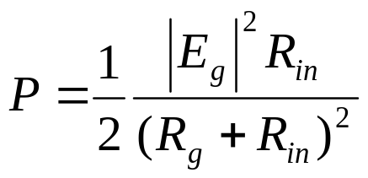

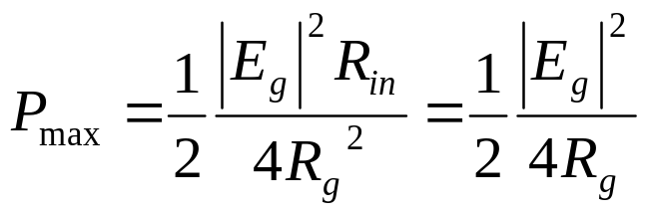

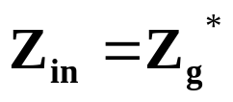
§3.1 Generator and load mismatches
Power delivered to the load

Slide 3
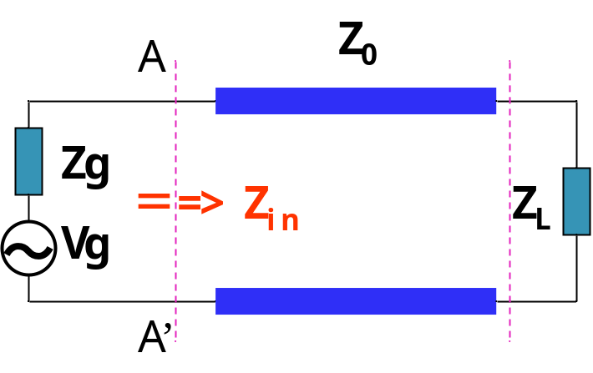
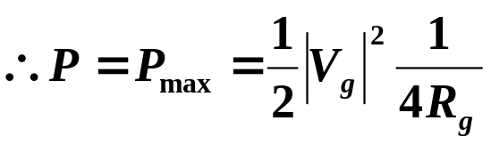
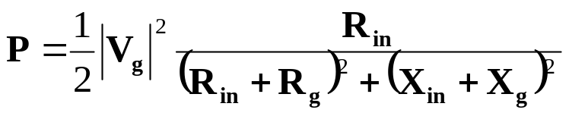

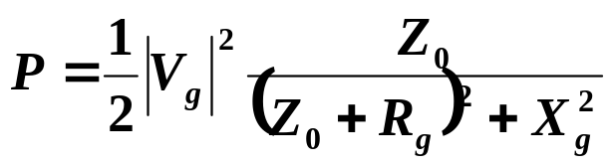
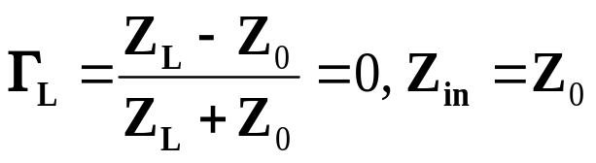

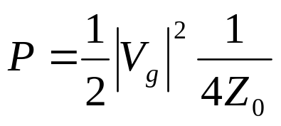
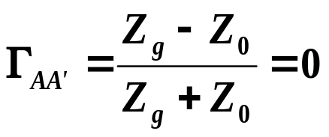
§3.1 Generator and load mismatches
Conjugate Matching
Load Matched to Line
Real value
Generator Matched to Loaded Line
Real value

Slide 4
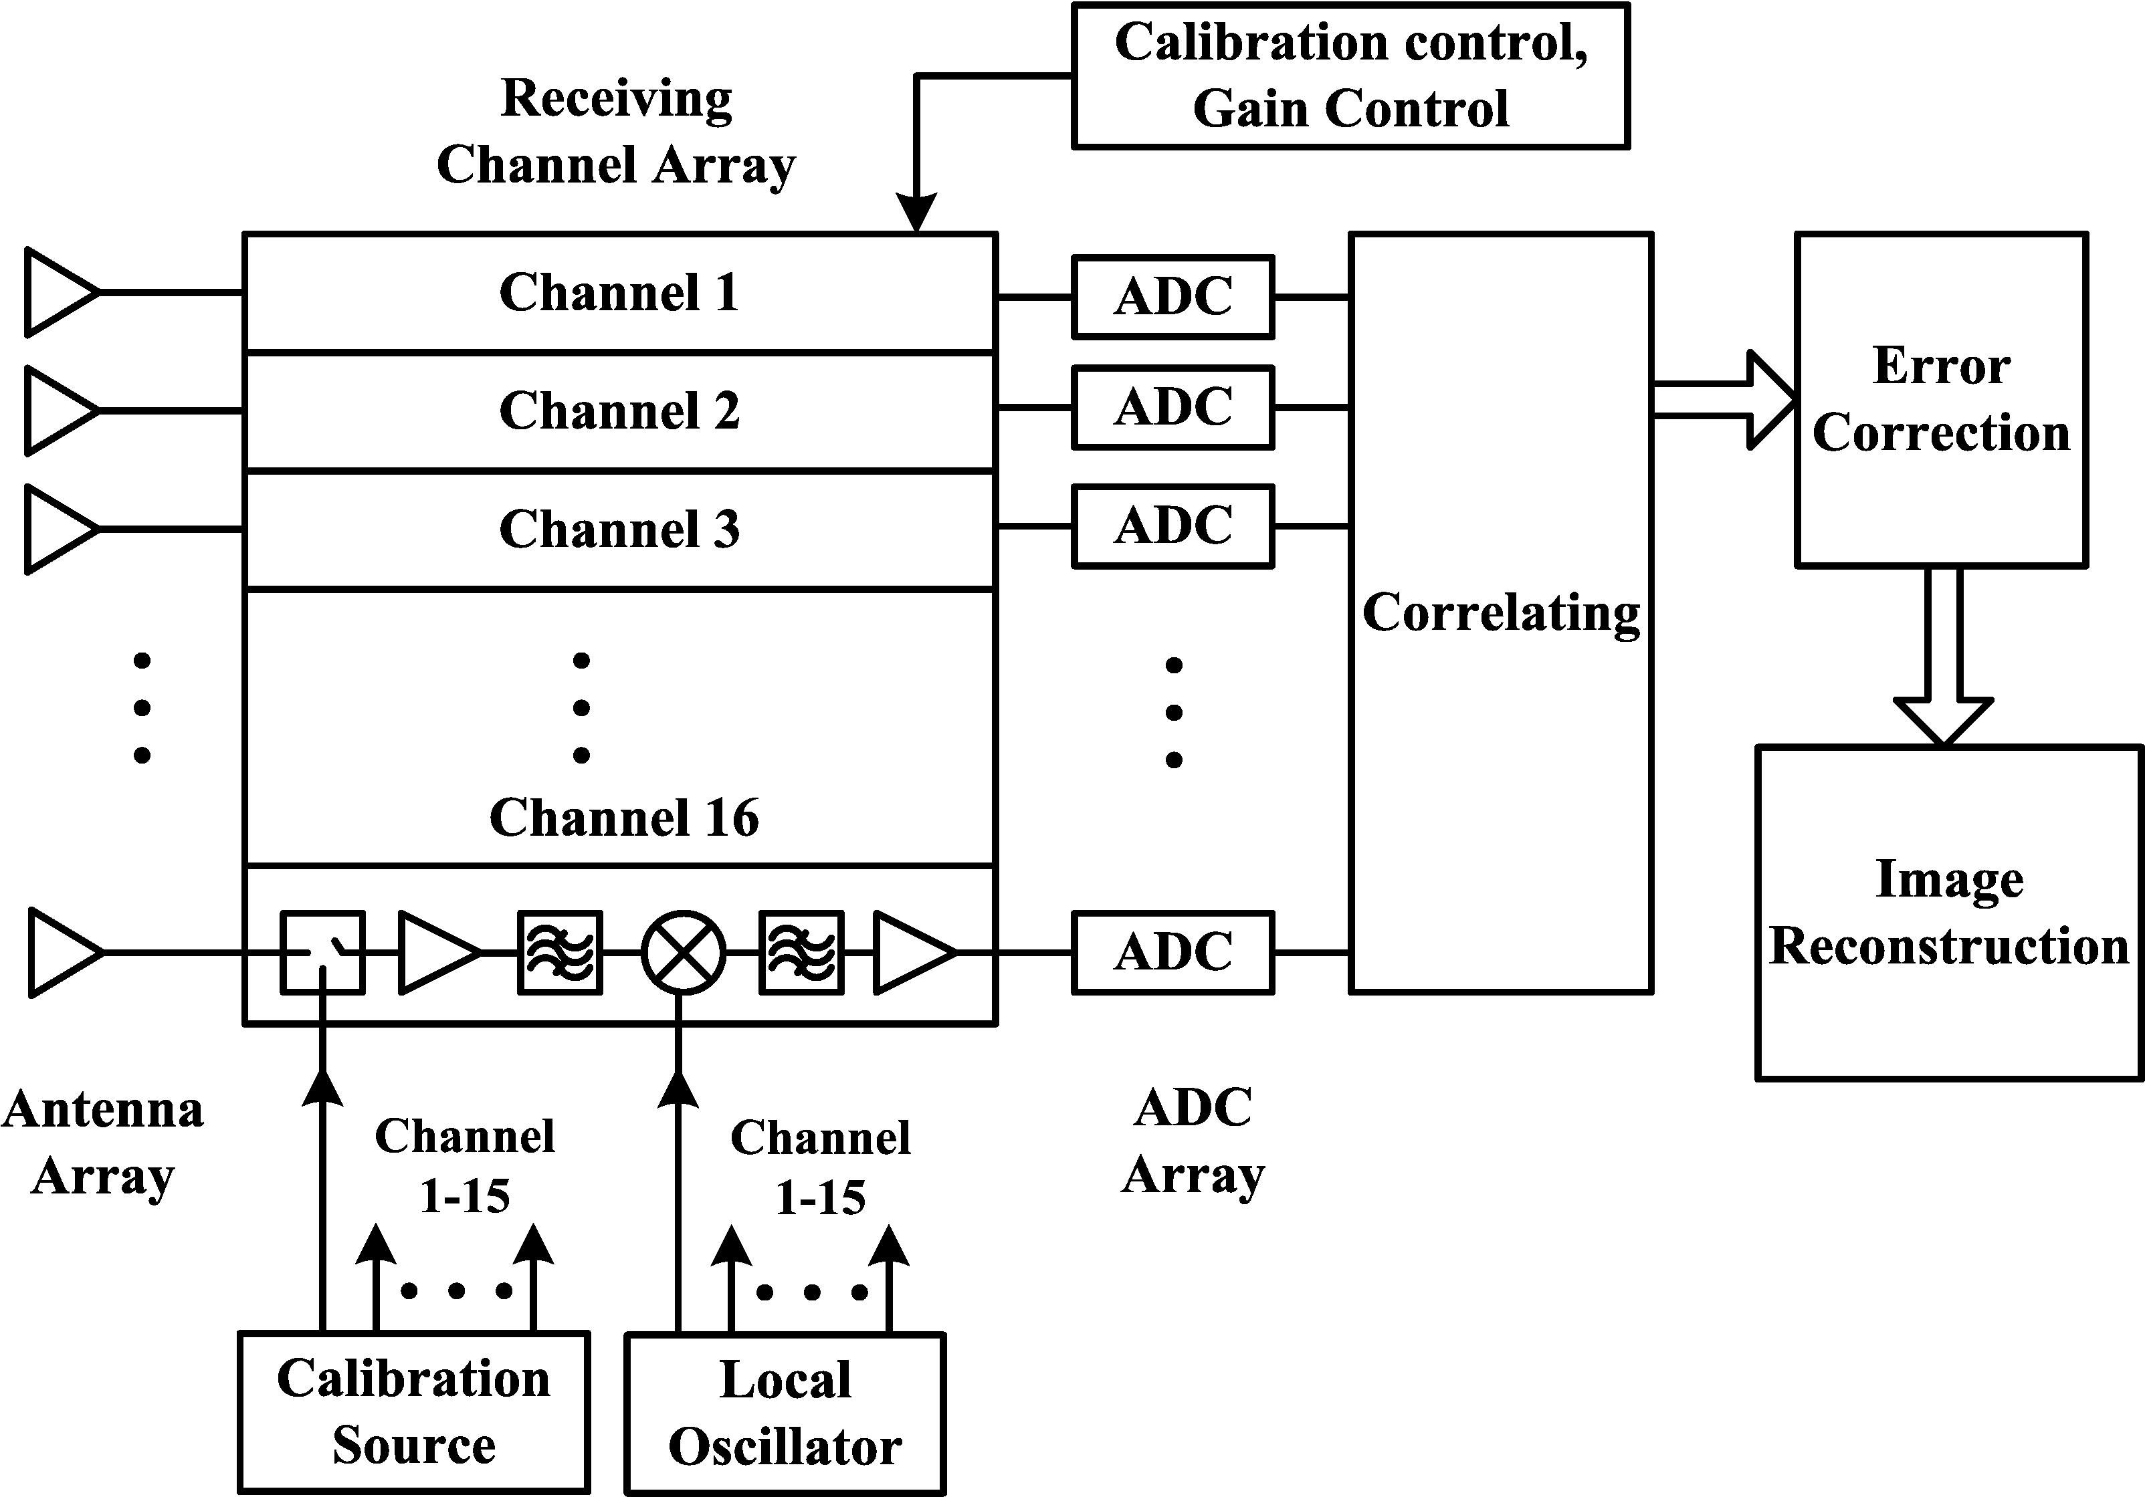
Impedance Matching is very important
§3.1 Generator and load mismatches
Max. power is delivered when the load is matched to the line (assuming the generator is matched), and power loss in the feed line is minimized
Impedance matching sensitive receiver components (antenna, LNA, etc.) improves the SNR of the system.
Impedance matching in a power distribution network (such as an antenna array feed network) will reduce amplitude and phase errors.

Slide 5
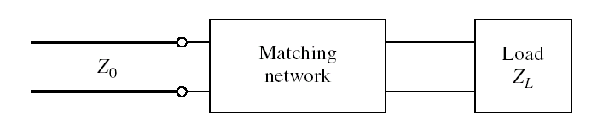
§3.1 Generator and load mismatches
Factors that may be important in the selection of a particular matching network include the following:
Complexity:
  A simpler matching network is usually cheaper, more reliable, and less lossy than a more complex design；
Bandwidth：
may be desirable to match a load over a band of frequencies；
Implementation
Adjustability ：
  to match a variable load impedance
How to match:

Slide 6
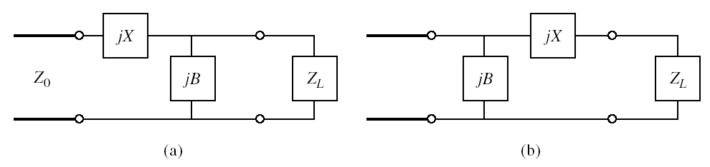
Fig. L-section matching networks.
(a) Network for z_{L} inside the 1 + jx circle. (b) Network for z_{L} outside the 1 + jx circle.
§3.2 Matching with Lumped Elements
(L networks)

Slide 7
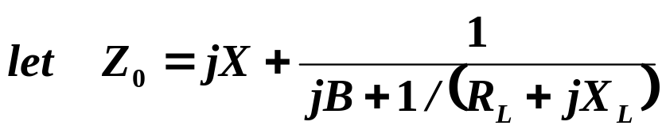
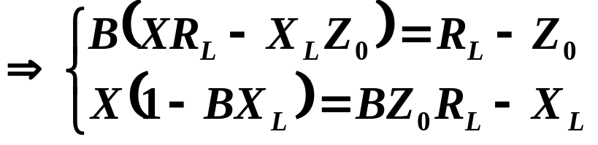
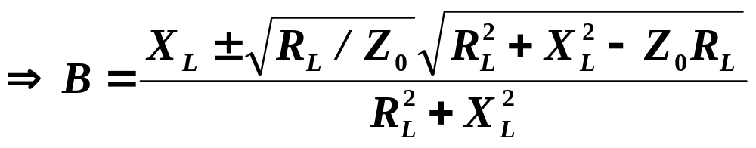
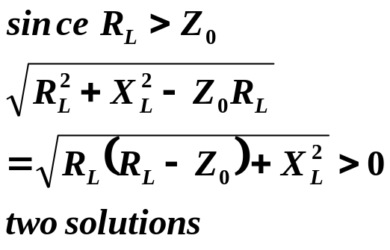
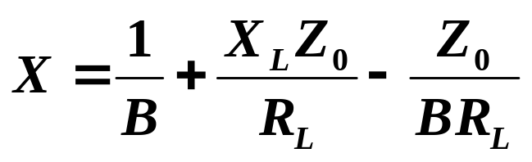
§3.2 Matching with Lumped Elements (L networks)
1. Analytic Solution
(a) Network for z_{L} inside the 1 + jx circle

Slide 8
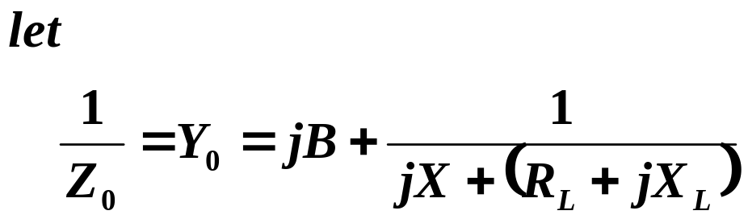
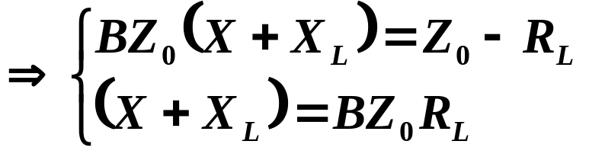
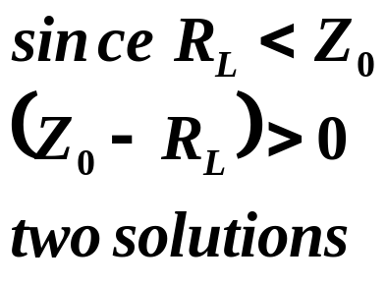
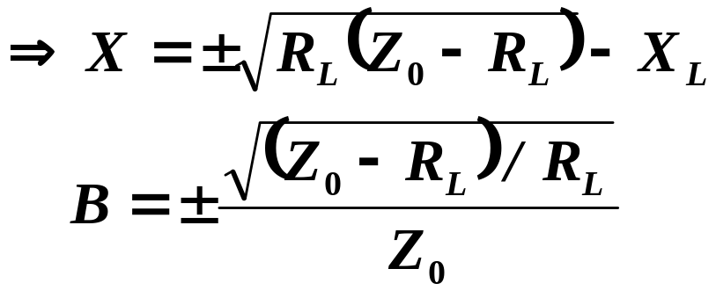
§3.2 Matching with Lumped Elements (L networks)
(b) Network for z_{L} outside the 1 + jx circle

Slide 9
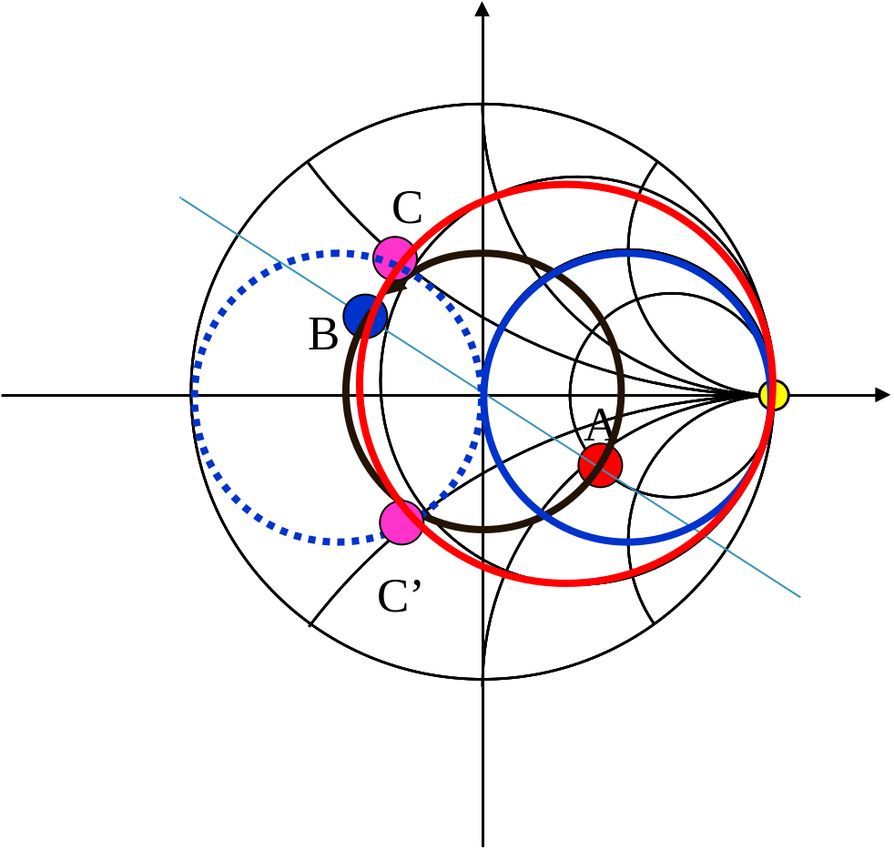

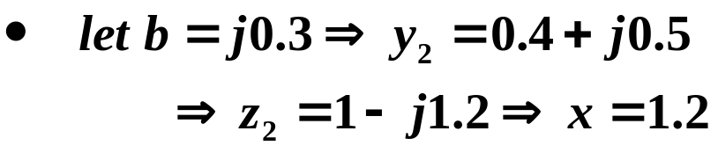
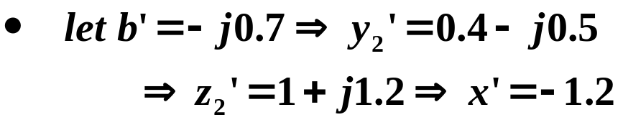
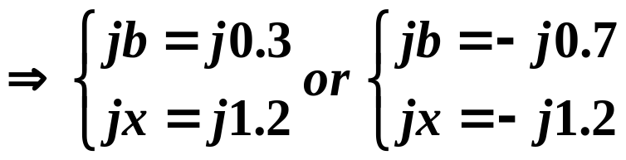
§3.2 Matching with Lumped Elements (L networks)
2. Smith Chart Solution
A
B
C
C’

Slide 10
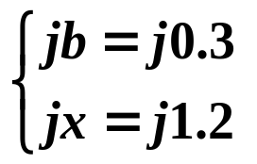
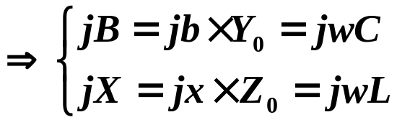
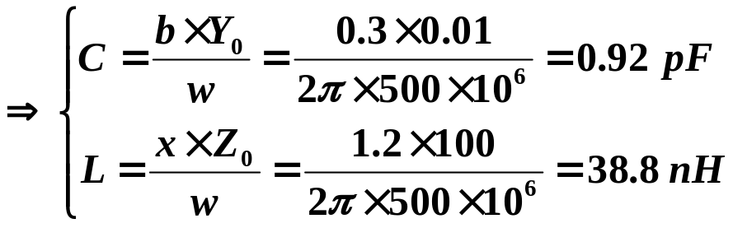
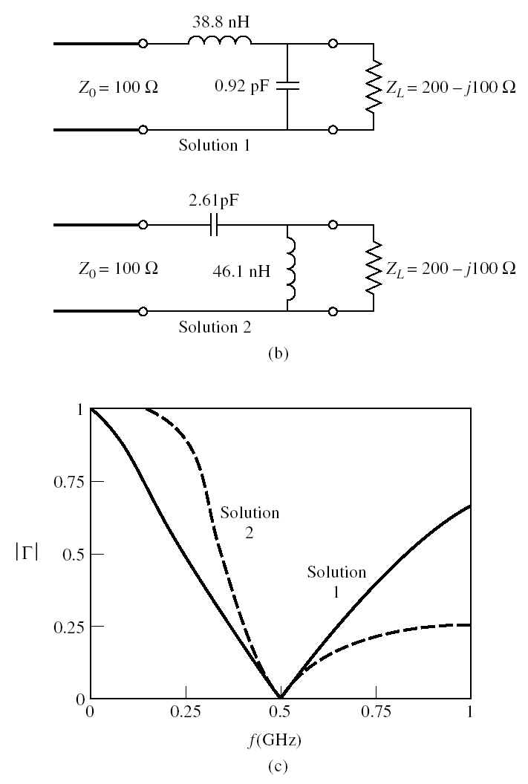
§3.2 Matching with Lumped Elements (L networks)
|Γ| versus frequency

Slide 11
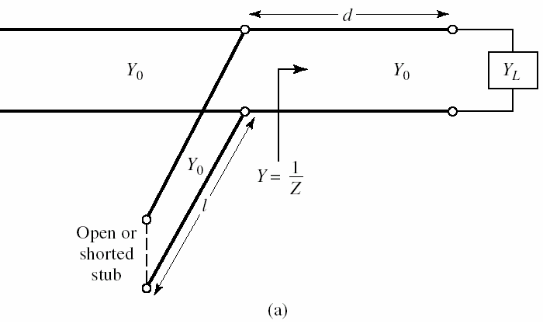
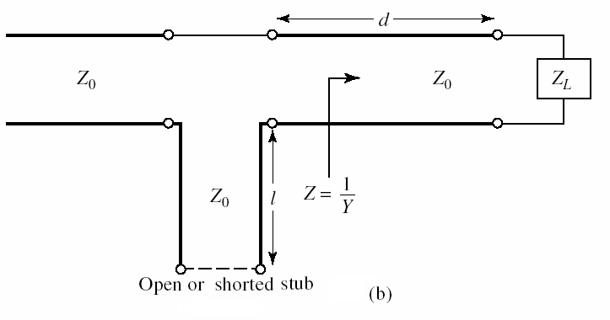
§3.3 Single-Stub Tuning
a matching technique that uses a single open-circuited or short-circuited length of transmission line (a "stub"), connected either in parallel or in series with the transmission feed line at a certain distance from the load.

Slide 12

§3.3 Single-Stub Tuning
d
1. shunt-stub tuner
d，l adjustable
Z_{L}
B
A
Basic Idea
  select d（d<λ/2）,
  so that y₁=1+jb
  （detemine d）
  the stub reactance is chosen as y₂=-jb₁
  （detemine l）
  then，y=y₁+y₂=1
l
d
jb
Z_{L}
ρ＝1
ρ≠1

Slide 13
§3.3 Single-Stub Tuning—— 1. shunt stubs
d
normalized impedance y_{L}，
→ point A
rotate to g＝1 circle
→ point B/ B’，
（determine d）
then y_{B}＝1+jb or y_{B’}＝1-jb
adjust the length l of stub,
y_{stun}=-jb or +jb
matched: y=1
jB
Z_{L}
B
A
A
B
B’
Admittance Smith Chart

Slide 14


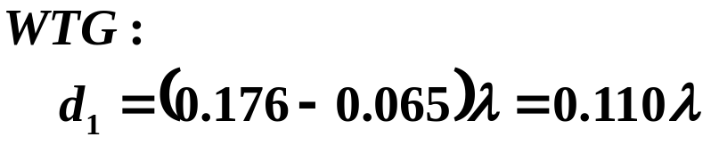

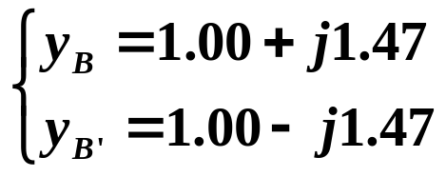
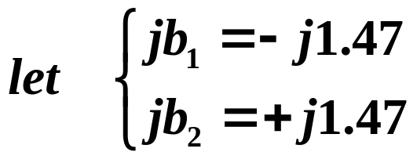
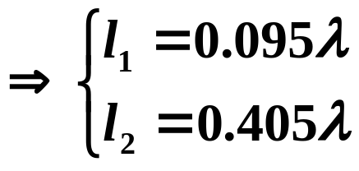
§3.3 Single-Stub Tuning—— 1. shunt stubs
d
Example：single-stub shunt tuning
for Z_{L}=60-j80Ω, Z₀=50Ω@2GHz
jB
Z_{L}
Solution ( Smith Chart)
B
A
A’
B
B’
A

Slide 15
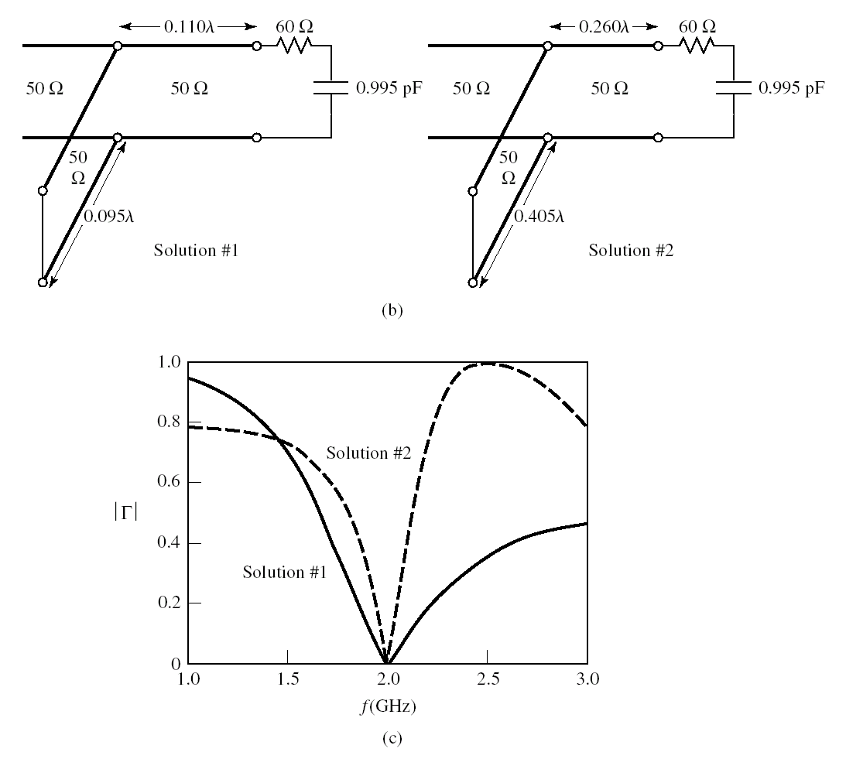
§3.3 Single-Stub Tuning—— 1. shunt stubs
frequency dependence

Slide 16

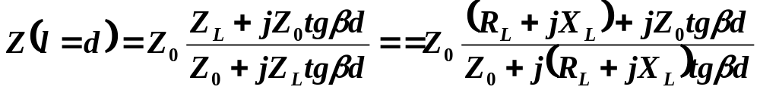
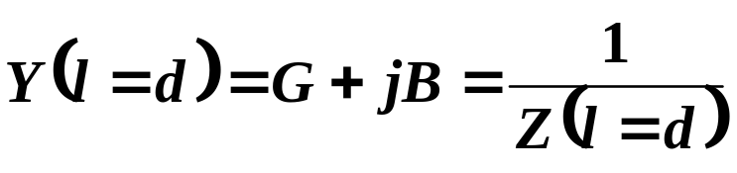
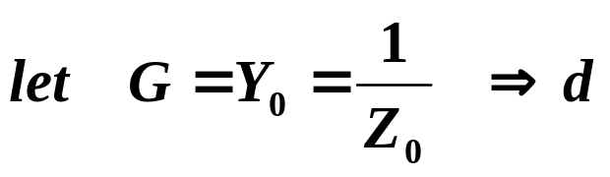
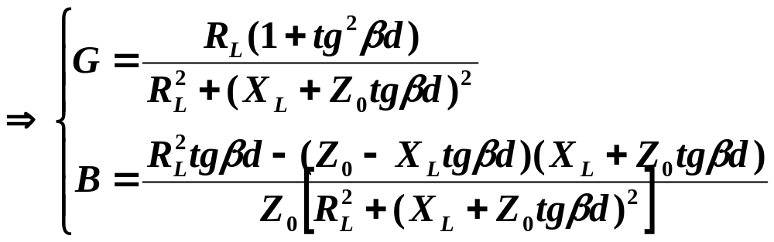

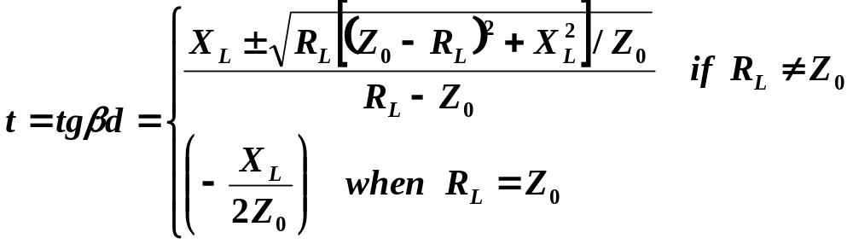
§3.3 Single-Stub Tuning—— 1. shunt stubs
d
Solution by formulas
jB
Z_{L}

Slide 17




§3.3 Single-Stub Tuning—— 1. shunt stubs
for short-circuit stub
for open-circuit stub

Slide 18





§3.3 Single-Stub Tuning
2. Series-stub tuner
Example：for Z_{L}=100+j80Ω,
Z₀=50Ω@2GHz
Smith Chart Solution
0.172
B
0.208
A
B’
0.328

Slide 19

§3.3 Single-Stub Tuning-2 series stubs
|Γ| versus frequency

Slide 20







§3.3 Single-Stub Tuning—— 2. series stubs
Solution by formulas

Slide 21



§3.3 Single-Stub Tuning—— 2. series stubs
for short-circuit stub
for open-circuit stub
match any load impedance (R_{L}≠0)
limitations:
  requiring a variable length d

Slide 22

§3.4 Double-Stub Tuning
use two tuning stubs in fixed positions
d₁ and d₂，
d₂：λ/8,λ/4 or 3λ/8，
not λ/2
adjust l ₁，l₂

Slide 23


§3.4 Double-Stub Tuning
steps
  fix on the assistant circle with d₂
  y_{L} → point A (y_{A})
  adjust stub1，move along the conductance circle，intersect the assistant circle → point A’
  rotate along the Γ circle to g＝1 circle → B’
  adjust stub2，move along the g＝1 circle to matched point → B
two possible solutions

Slide 24


§3.4 Double-Stub Tuning
Forbidden range：
  conductance circle tangent with the g=1 circle

Slide 25

§3.5 Triple-Stub Tuning
usually d₃＝d₂=λ/4 （orλ/8）
adjust：l ₁，l₂ ，l₃

Slide 26






§3.6 The Quarter-Wave Transformer
Basic theory
(1) if Z_{L}＝R_{L}≠ Z₀ is pure impedance
let Z_{in}＝Z₀
  since
Z_{L} should be real ?complex

Slide 27

§3.6 The Quarter-Wave Transformer
(2) if Z_{L}＝R_{L}+jX_{L} is complex impedance
Vmin or Vmax
Z_{in}=Z₀/ρ or ρZ₀

Slide 28



§3.6 The Quarter-Wave Transformer
Example：a Z₀＝75Ω line，terminated with load Z_{L}＝(150＋j300) Ω, detuning with an quarter-wave transformer
Find: d and Z₀₁
Solution：Smith Chart
(1) z_{L}=Z_{L}/Z_{C}=2+j4 →point A 0.218
(2) VSWR≈11
(3) Find Z₀₁ of theλ/4 line
(4) Inserting position d
d_{max}＝(0.25-0.218)λ=0.032λ
d_{min}＝(0.50-0.218)λ=0.282λ

Slide 29



§3.6 The Quarter-Wave Transformer
Solution by formulas

Slide 30






§3.6 The Quarter-Wave Transformer
A single-section quarter-wave matching at the design frequency f₀.

Slide 31








§3.6 The Quarter-Wave Transformer

Slide 32



§3.6 The Quarter-Wave Transformer
Set a maximum value, Γ_{m} of the reflection coefficient magnitude that can be tolerated, then we can define the bandwidth of the matching transformer as
Approximate behavior of |Γ| for a single-section quarter-wave transformer operating near its design frequency.

Slide 33







§3.6 The Quarter-Wave Transformer
If we assume TEM lines, then
Fractional bandwidth:
Note ：
bandwidth increases as Z_{L} becomes closer to Z₀ (a less mismatched load).

Slide 34

§3.6 The Quarter-Wave Transformer
Note:
the trend of increased bandwidth for smaller load mismatches
|Γ| versus frequency with various load mismatches.

